Slide 1
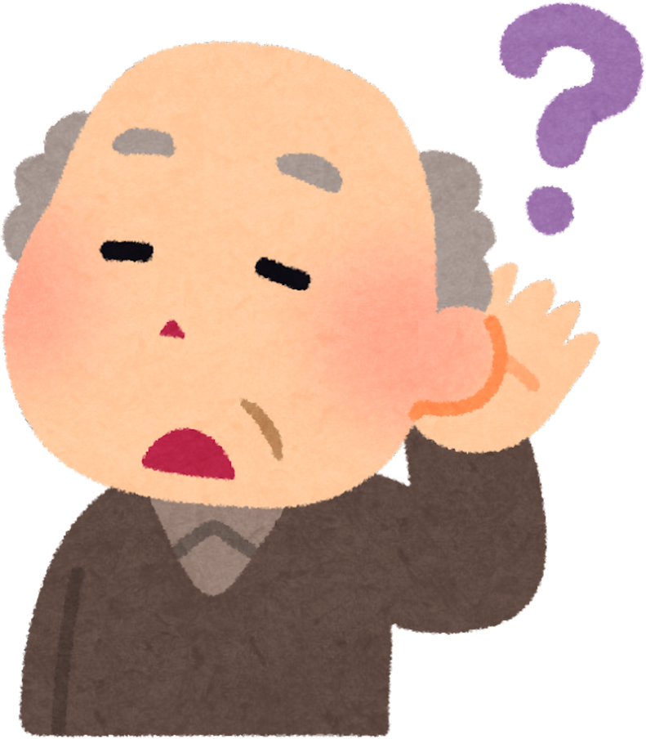


UNIACCESS – ALL-IN-ONE ACCESSIBILITY ASSISTANT

Slide 2

PROBLEM STATEMENT
Many digital platforms are not inclusive.
Users with hearing, speech, or vision impairments struggle to communicate or access information.

Slide 3
MOTIVATION
WHY THIS PROJECT MATTERS:
Digital inclusion for all
Empower users with disabilities
Reduce communication barriers

Slide 4
SOLUTION OVERVIEW
UNIACCESS IS AN AI-POWERED PLATFORM COMBINING:
Real-time captioning
Sign language translation
Color-blind friendly mode

Slide 5
FEATURE 1 – REAL-TIME AI CAPTIONING
Converts speech to live captions
Multi-language support
Helps hearing-impaired users follow conversations

Slide 6
FEATURE 2 – SIGN LANGUAGE TRANSLATOR
Detects basic hand gestures via webcam
Converts signs into text/speech
Optional animated sign avatar

Slide 7
FEATURE 3 – COLOR-BLIND FRIENDLY MODE
Adjusts web colors for better visibility
Detects problematic color combinations automatically

Slide 8
HOW IT WORKS / ARCHITECTURE
Flow:
User → AI Processing → Output

Slide 9
IMPACT & BENEFITS
Empowers hearing, speech, and vision-impaired users
Cost-effective and scalable
Promotes digital inclusion

Slide 10
CONCLUSION & CALL TO ACTION
UniAccess makes the digital world inclusive for everyone.
Let’s use AI to break barriers and empower users with disabilities.

Slide 11
THANK YOU

